Slide 1
Cognitive Science for AI
Language: Form

Slide 2
Language
Complex sound waves converted to meaning
Form
Phonology - language specific perception and production
Morphology/Syntax - how to put words together
Meaning
Lexicon - word meaning, associations
Semantics - the sentence, logic, relations
Pragmatics - what you really mean in context
Discourse Analysis - mental model, pronoun resolution

Slide 3
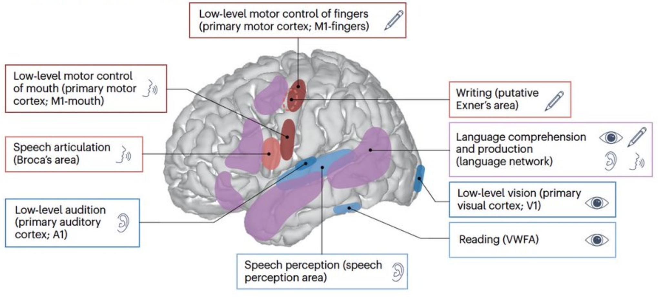
Brain areas that correspond to linguistic stimuli
https://www.nature.com/articles/s41583-024-00802-4.epdf

Slide 4
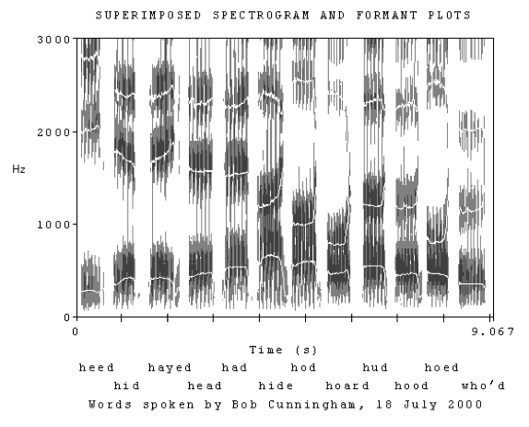
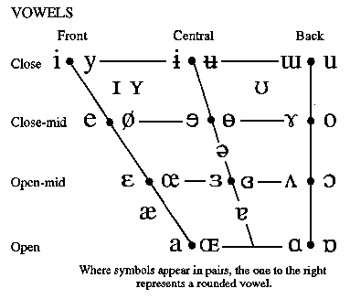
Form: Phonology
IPA - International Phonetic Alphabet
Formant bands for vowels
https://home.cc.umanitoba.ca/~krussll/138/sec5/vowels1.htm

Slide 5
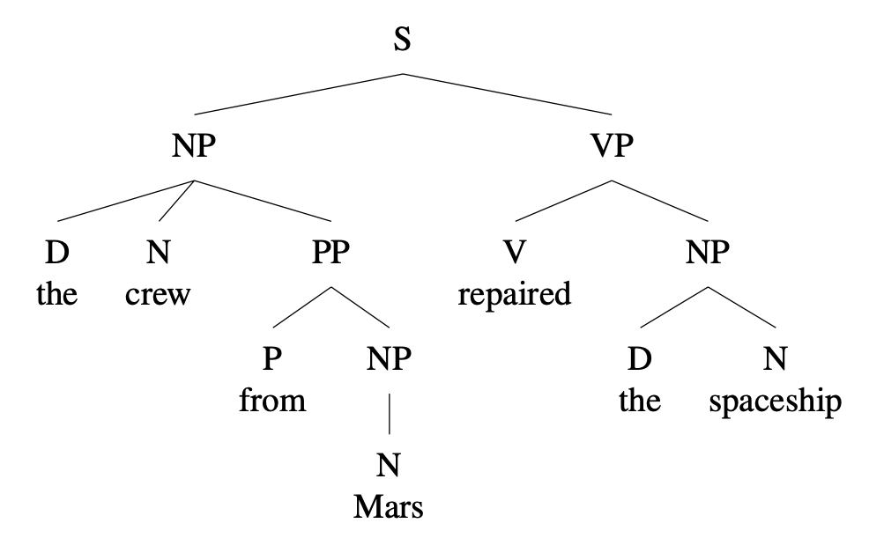
Syntax - Word Order
Parse Tree Grammars
S -> NP VP
NP -> (D) N (PP)
PP -> Prep NP
D -> the | this | that | a | an
N -> crew | Mars | spaceship
Prep -> of | in | from
VP -> V NP
V -> repair | repairs | repaired
https://ecampusontario.pressbooks.pub/essentialsoflinguistics2/chapter/from-constituency-to-tree-diagrams/

Slide 6
Morphology - Word Construction
Inflection - to have
singular plural
1st tengo tenemos
2nd tienes tienen
3rd tiene tienen
https://ecampusontario.pressbooks.pub/essentialsoflinguistics2/chapter/from-constituency-to-tree-diagrams/

Slide 7
Some Language Types
English He saw a cat in the hat.
French Il a vu un chat dans le chapeau.
He has seen a cat in the hat.
Latin Vidit felem in petasum.
He-saw cat-obj in hat.
Irish Chonaic sé cat sa hata.
Saw he cat in hat.
Hindi उसने टोपी में एक बिल्ली देखी।
He (the) hat in a cat sees.
Russian видел кошку в шляпе.
He-saw cat in hat.
Swahili Aliona paka kwenye kofia.
He-past-see cat in hat.
Chinese 他看到一只猫戴着帽子。
He see a cat in hat (done).
Word Order
SVO - English Chinese Russian French Swahili
SOV - Hindi
VSO - Irish
Pronoun-drop
Yes - Russian Latin Swahili
No - English French Irish
Verb formation
Inflected - Latin Russian Hindi Irish French
Agglutinative - Swahili
Analytic - English Chinese
Articles
Indef and Def - English French
Indef - Hindi
None - Latin Chinese Russian Swahili Irish

Slide 8
Cognitive Science for AI
Language: Meaning

Slide 9
Semantics
“There is not a person in this courtroom who has never told a lie, who has never done an immoral thing, and there is no man living who has never looked upon a woman without desire.”
Atticus Finch in ‘To Kill a Mockingbird’
What does this mean?
The logical, primary meaning in first order logic
¬ ∃ x [ P(x) ^ C(x) -> ¬L(x) ^ ¬I(x) ] ^
¬ ∃ x [M(x) ^Liv(x) -> ¬ Look(x, y) ^ Des(x,y)]
The intention, what it is trying to get you to think
Emotional consequences

Slide 10
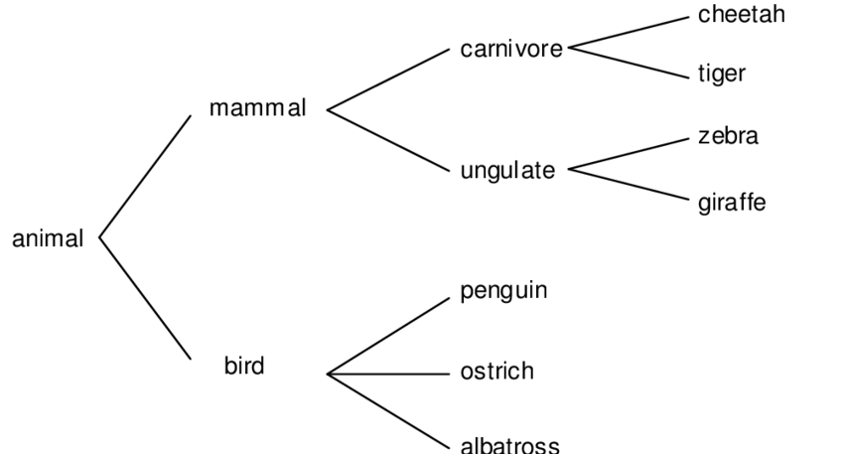
Lexicon - the set of words in a language
Prototype
Central concept w fuzzy extent
Exemplars
List of examples
Semantic features
Queen = -male | +ruler | +face-card
Jack = +male | -ruler | +face-card
Modeled with a bit vector
Taxonomy - simple relation
Synonyms, Antonyms, Hypernyms
Ontology - Concepts with many relations
WordNet English taxonomy
Entity-Relationship diagram, Frames

Slide 11
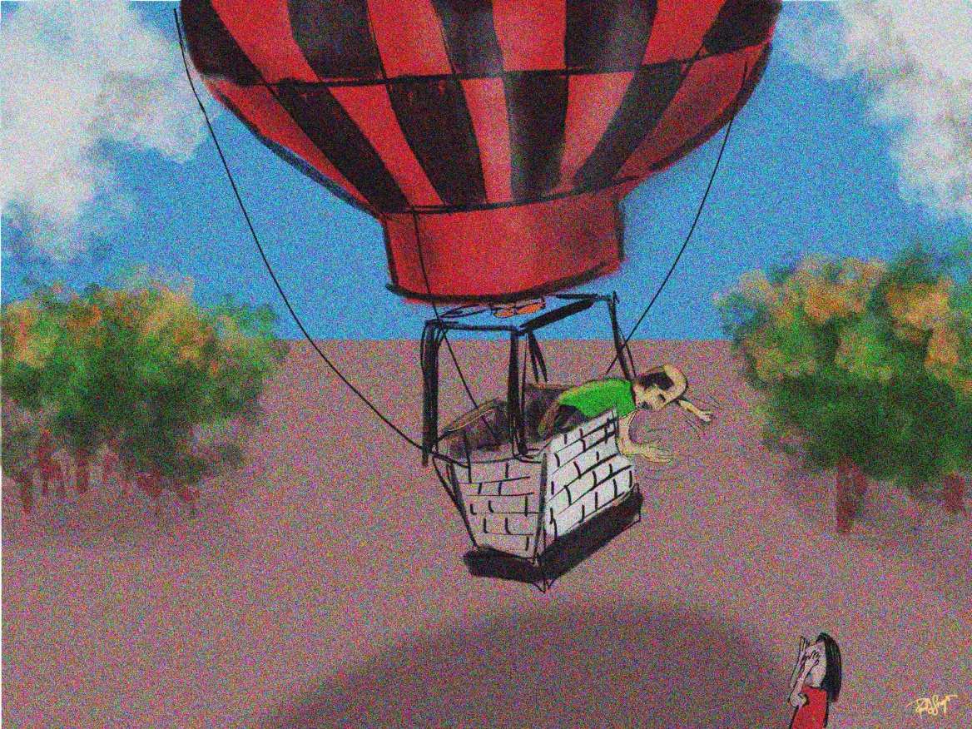
Pragmatics
Context and intention
Common sense, sociolinguistics
Implicature
what you would have said
“Do you know what time it is?”
“It’s 5 o’clock”
“Yes, I do”
“OMG, I’m late already”
https://portfoliolongo.com/2014/10/11/the-balloonist-and-the-hiker-an-evaluator-joke/

Slide 12
Example: Grice’s maxims of conversation
Maxim of quantity - Say what is needed but no more
Maxim of quality - Say the truth
Do not say what you believe is false
Do not say that for which you lack adequate evidence
Maxim of relevance - Be relevant.
Omit any irrelevant information
Maxim of manner - Be clear
Avoid obscurity
Avoid ambiguity
Be orderly
Principles of information exchange - depends on context

Slide 13
Discourse Analysis
“It is a truth universally acknowledged, that a single man in possession of a good fortune must be in want of a wife. However little known the feelings or views of such a man may be on his first entering a neighbourhood, this truth is so well fixed in the minds of the surrounding families, that he is considered as the rightful property of some one or other of their daughters.” Jane Austen ‘Pride and Prejudice’
What is going on? Who is referring to what? How does the second sentence explain or elaborate on the first? What are the properties of this way of communicating?

Slide 14
Lessons from Linguistics
Form is arbitrary, it doesn’t have to be this way
Every language is learnable by 3-5 yr olds - poverty of the stimulus
Translation is hard, not word for word, ‘You just don’t say it that way’
Translation is always possible - you can express the same idea in any language
Words are not concepts
but how we know about concepts is through words
Language is not writing
but mostly what we have is (disembodied) text
Most words have more than one meaning
Mostly compositional but allows idioms
Most utterances are not literal, meanings drift, many words started off as metaphors
Use vs mention - quotes hide meaning, but meaning leaks through
Human language is both biological and cultural - necessary features for our speech in mouth/throat/lungs, ears/brain, (but sign language!), and other animals have lots of linguistic potential, but we (humans) learn vocab and syntax and sounds from others

